Slide 1
Mad River Local Schools Board of Education Mission and Goals 2022
Prepared by: mad river’s board of education, superintendent, assistant superintendent, hr director, and treasurer

Slide 2
Mission
“The mission of the mad river board of education, in partnership with our community, is to promote a culture of excellence and develop policies to best meet the needs of students”

Slide 3
Community Stakeholders
Students
Parents
Residents
State and local government leaders
Local business owners
Community organizations
Staff
District administration
Board of education

Slide 4
Strategic Goals, Actions and Resources
Goal 1: community involvement
The mad river board of education will encourage more consistent community involvement within the school system
Actions
Model involvement by being present during community events
Annual surveys of parents, community members, and staff to evaluate engagement
Assist buildings in promoting parent involvement in the schools
Resources
Calendar of district events
Calendar of school events
Survey tool and data
Feedback on building challenges with parent involvement

Slide 5
Strategic Goals, Actions and Resources
Goal 2: student voices
The mad river board of education will create opportunities to engage student voices in board actions and processes
Actions
Create student opportunities for feedback and input
Student board representatives from SHS
Student showcases at scheduled board meetings
Resources
Survey tool and data
Identification process for student representatives from SHS

Slide 6
Strategic Goals, Actions and Resources
Goal 3: data analysis
The mad river board of education will engage in in-depth financial and academic data analysis to make informed decisions on continuous improvement
Actions
Designated board member will be present to observe district DLT meetings
District board finance committee will be created
Establish biannual special board meetings to engage in in-depth financial and academic data analysis
Resources
District DLT meeting schedule
District academic report card data
District formative and summative assessment data
District summary of results of current OIP
District finance committee meeting schedule
District financial data

Slide 7
Strategic Goals, Actions and Resources
Goal 4: Policy
The board of education will continuously evaluate policy to ensure the approved policy carries out the board of education’s mission (purpose)
Actions
Utilize special board meetings dedicated to policy analysis and/or evaluation to make informed decisions on district policy as needed
Resources
Board policy (available on the district website)
Updated policy (hard copies) provided by the superintendent for 1st and 2nd readings prior to approval
NEOLA legal updates and policy summaries for background knowledge

Slide 8
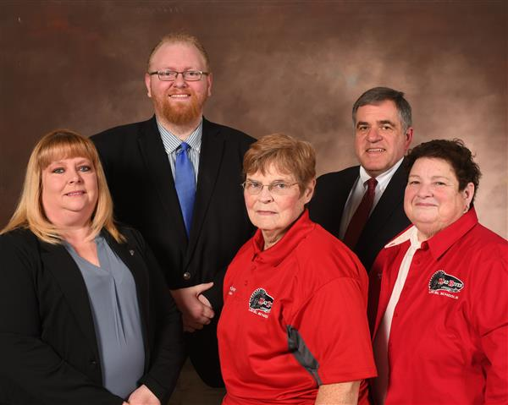
Mad River Local Schools Board of Education Members
Front row (L-R):
Mrs. julie denning
Mrs. marilyn steiner
Ms. cristina pickle
Back row (L-R)
Mr. aj ricker
Mr. scott huddle

